Slide 1
Capstone Project
By: Shikher Singh
Mentor: Ankit Jain

Slide 2
Data-Set Default of credit card client data-set
Source: UCI machine learning
Abstract:
Number of Instances(30000)
Attributes (Integer, real)
Number of attributes(24): Amount of given credit to individual or family, gender, education status, marriage status, Age, History of payment( from April-September,2005), Amount of bill statement( from April-Sep,2005), Amount of previous payment(from April –Sep, 2005)

Slide 3
Problem Statement : This research aimed at the case of customers @ default payments and compares the predictive accuracy of probability of default among different classification methods. From the perspective of risk management, the result of predictive accuracy of the estimated probability of default will be more valuable than the binary result of classification - credible or not credible clients.
What to achieve: Y(0= No, 1= yes)
Whether client default on their credit card payment.

Slide 4
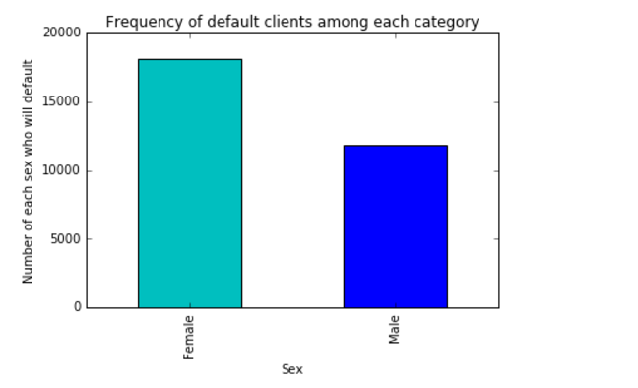
Data exploration & Facts:

Slide 5
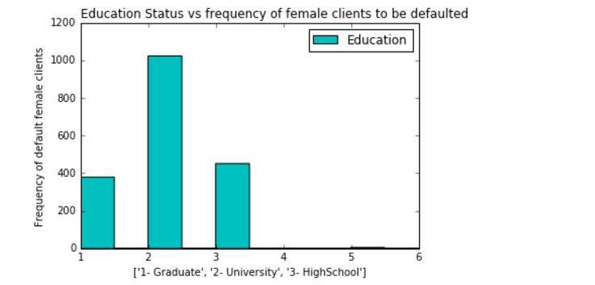
Married university passed out females are more likely to default than who are graduates/high-school passed out

Slide 6
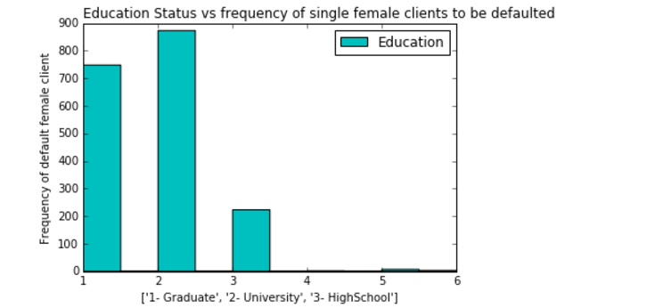

Slide 7
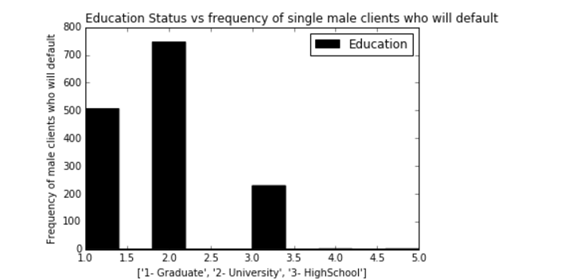
Same is true for Males:

Slide 8
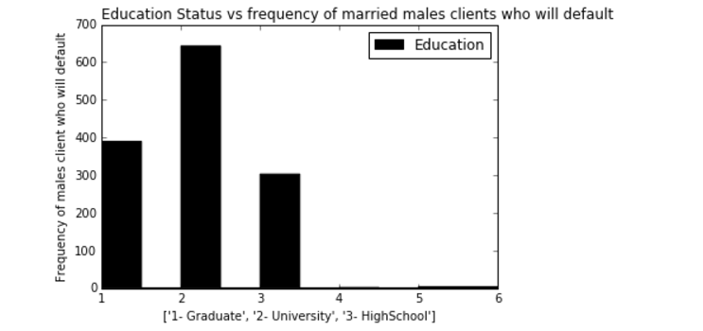

Slide 9
Recommendations:
Try to provide credit cards to males more as compared to females.
Always do education status check before providing cards to the client as proportion of default is very high in university passed out.

Slide 10
Supervised learning methods:
RandomForest : combination of ensemble methods
SVM : features should be scalable
Logistics regression: hyper-parameters
KNN: best neighbors to be picked
NaiveBayes: features should be independent

Slide 11
Logistics Regression:
Features to be excluded: Initial amount of balance given, bill amount in last 3 months as well as amount of previous statements in last 5 months excluded
Cross-validation : regularized parameter(C=1) was the best estimator
Max accuracy obtained: 79.53 (better than before)

Slide 12
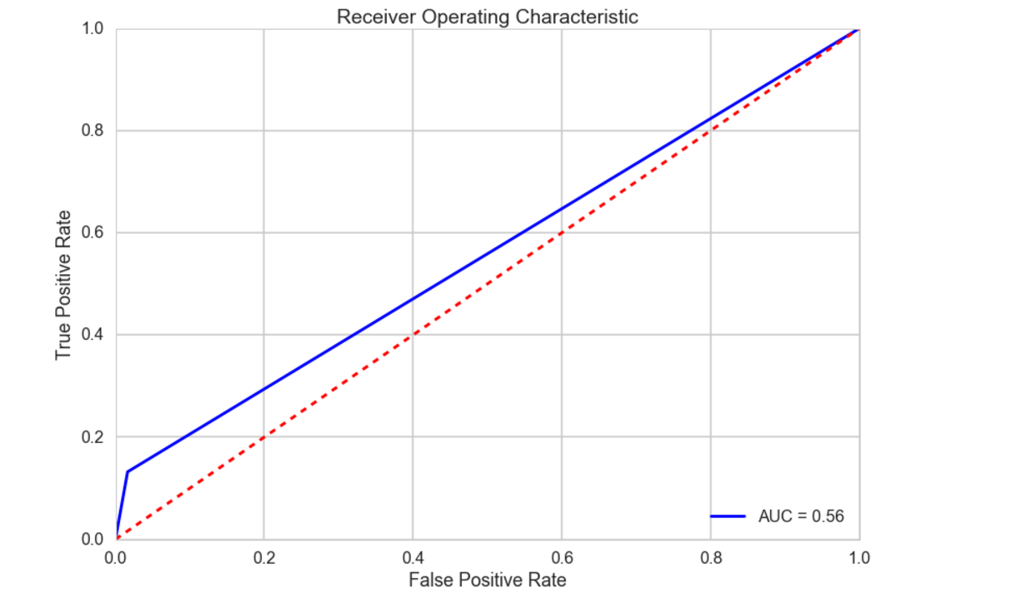
Roc-curve

Slide 13
Support Vector Machine
Features should be normalized.
Used cross-validation to get best Slack(C) and Gamma.
C=1, Gamma= 0.001, Kernel= RBF
Optimized accuracy: 78.24 %
Took more time to train the model

Slide 14
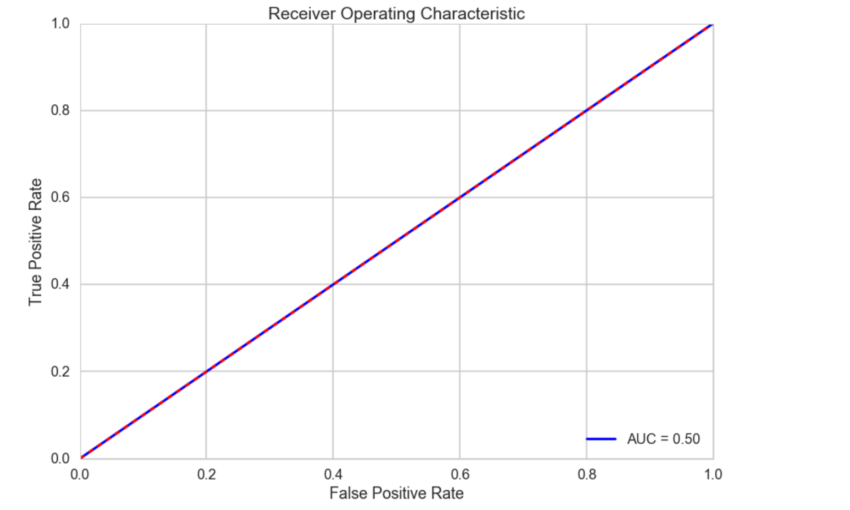
Roc-curve

Slide 15
K Nearest Neighbour:
Same features were excluded as was in Logistics Regression
Cross-validation was used to pick optimized value of neighbours
Neighbors-30
Accuracy achieved: 78.65%

Slide 16
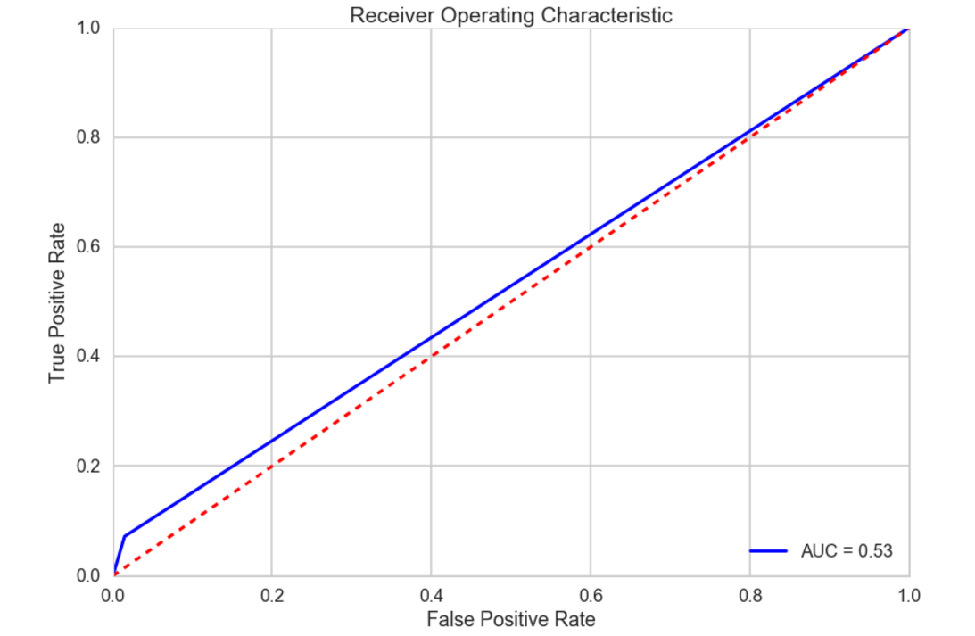
Roc-curve

Slide 17
NaiveBayes
Initial accuracy achieved was 36 percent and thought of reject naive-Bayes.
Go for independent features
Accuracy score achieved was 80.38% percent

Slide 18
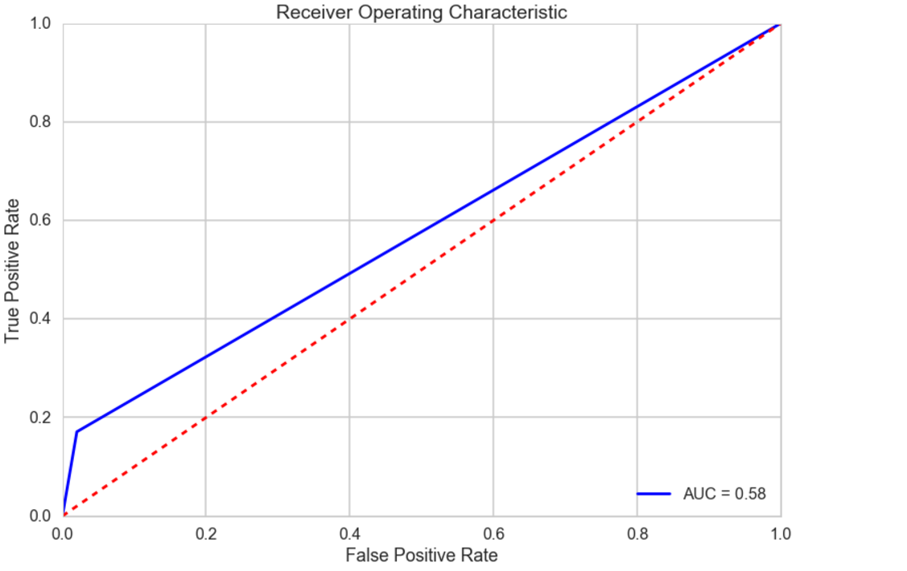
Roc-curve

Slide 19
RandomForest: The saviour
Why??

Slide 20
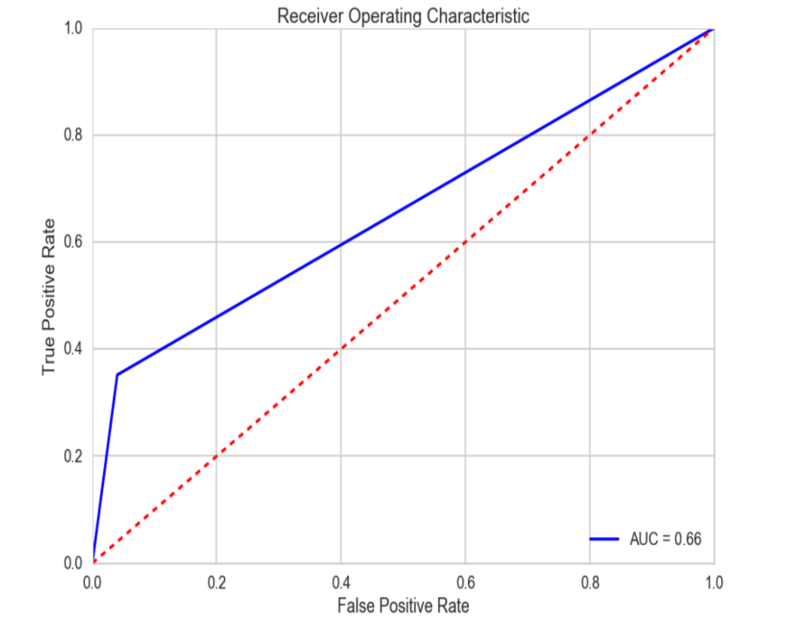



RandomForest
NaiveBayes
KNN
SVM

Slide 21
No normalization needed
More features were excluded such as history of payments for last 4 months
Pretty fast
Cross-validation were used to pick best features(Number of trees-20, maximum depth-7)
Accuracy score achieved: 82.77 %
So far the best estimator

Slide 22
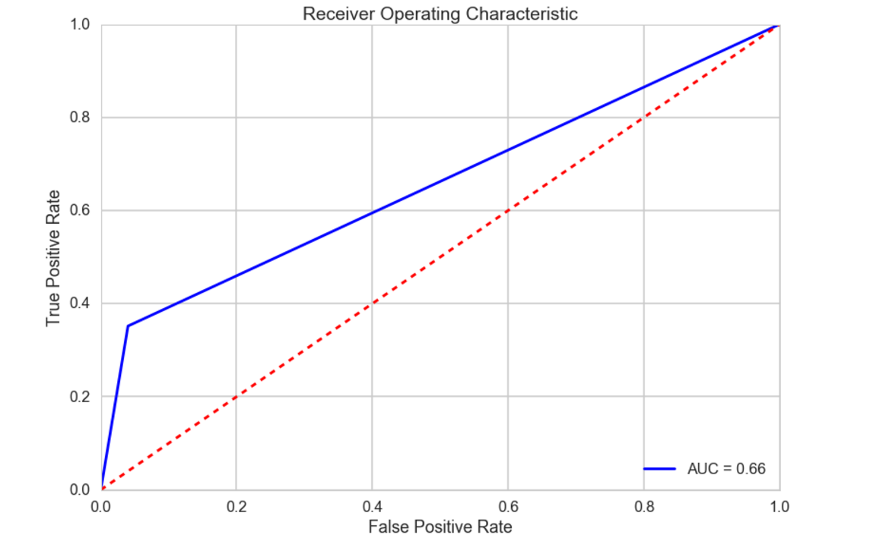
Roc-curve

Slide 23
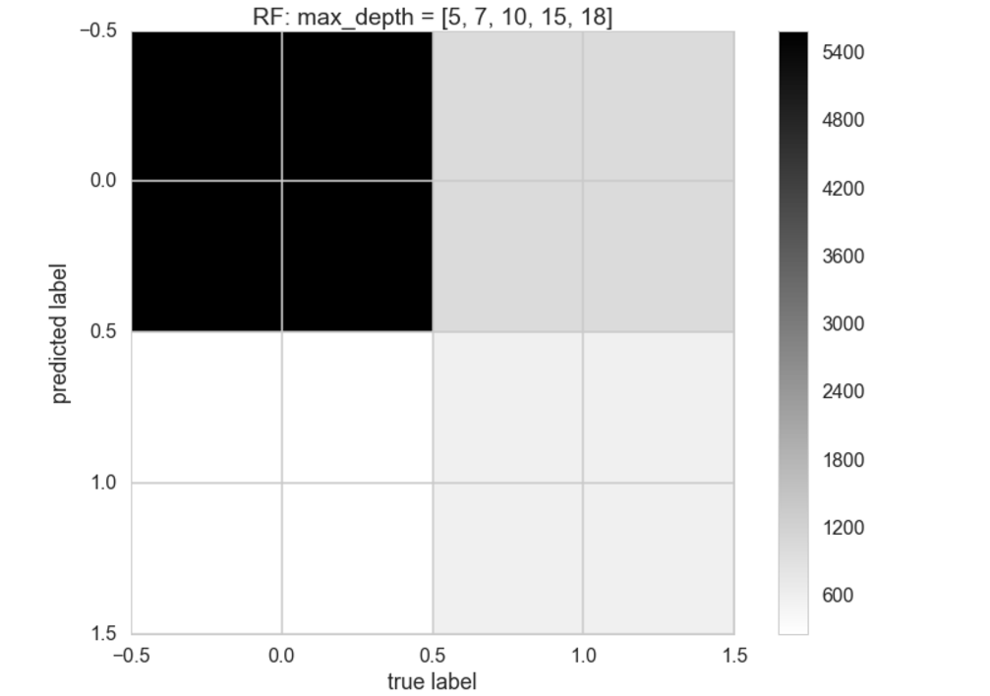

Slide 24
Q & A

Slide 25
If No question,
please provide more suggestions how to make it better model

